Slide 1
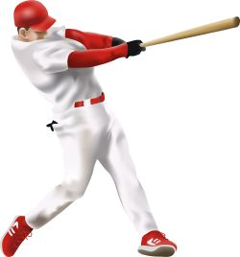
6.00 The batter
John watson

Slide 2
6.01
(A) Batting Order
(B) First Batter for the Next Inning
6.02
(A) Batter to promptly enter the Batter’s Box
(B) Batter not to leave box once the pitcher starts his
wind-up or comes to the “set” position
Penalty: If Pitcher pitches, call what it is. With runners on base
and the pitcher stops his motion, Don’t call a balk.
Don’t reward the Offense for their illegal action.

Slide 3
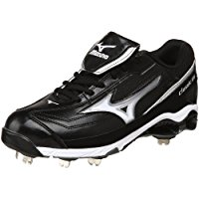
Rule 6.02 (C) –Local League Option:
The Batter must stay in the box with at least one foot
Exceptions:
On a swing, slap, or check swing
When forced out of the box by a pitch (brush back)
An attempted drag bunt
When the catcher fails to catch the ball, leaves his “playing area”
During an attempted play
Time has been called
When the pitcher leaves the dirt area of the mound
On a 3 ball count and the batter thinks it’s ball 4

Slide 4
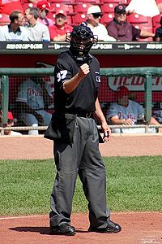
Rule 6.02 (C) –Local League Option:
The Batter must stay in the box with at least one foot
After an initial warning for first offense, the umpire will call a “strike” for each subsequent offense.
Majors: The pitcher does not have to throw a pitch; the ball is dead, and no runners may advance.
Juniors/ Seniors: The pitcher does not have to throw a pitch; the ball is live

Slide 5
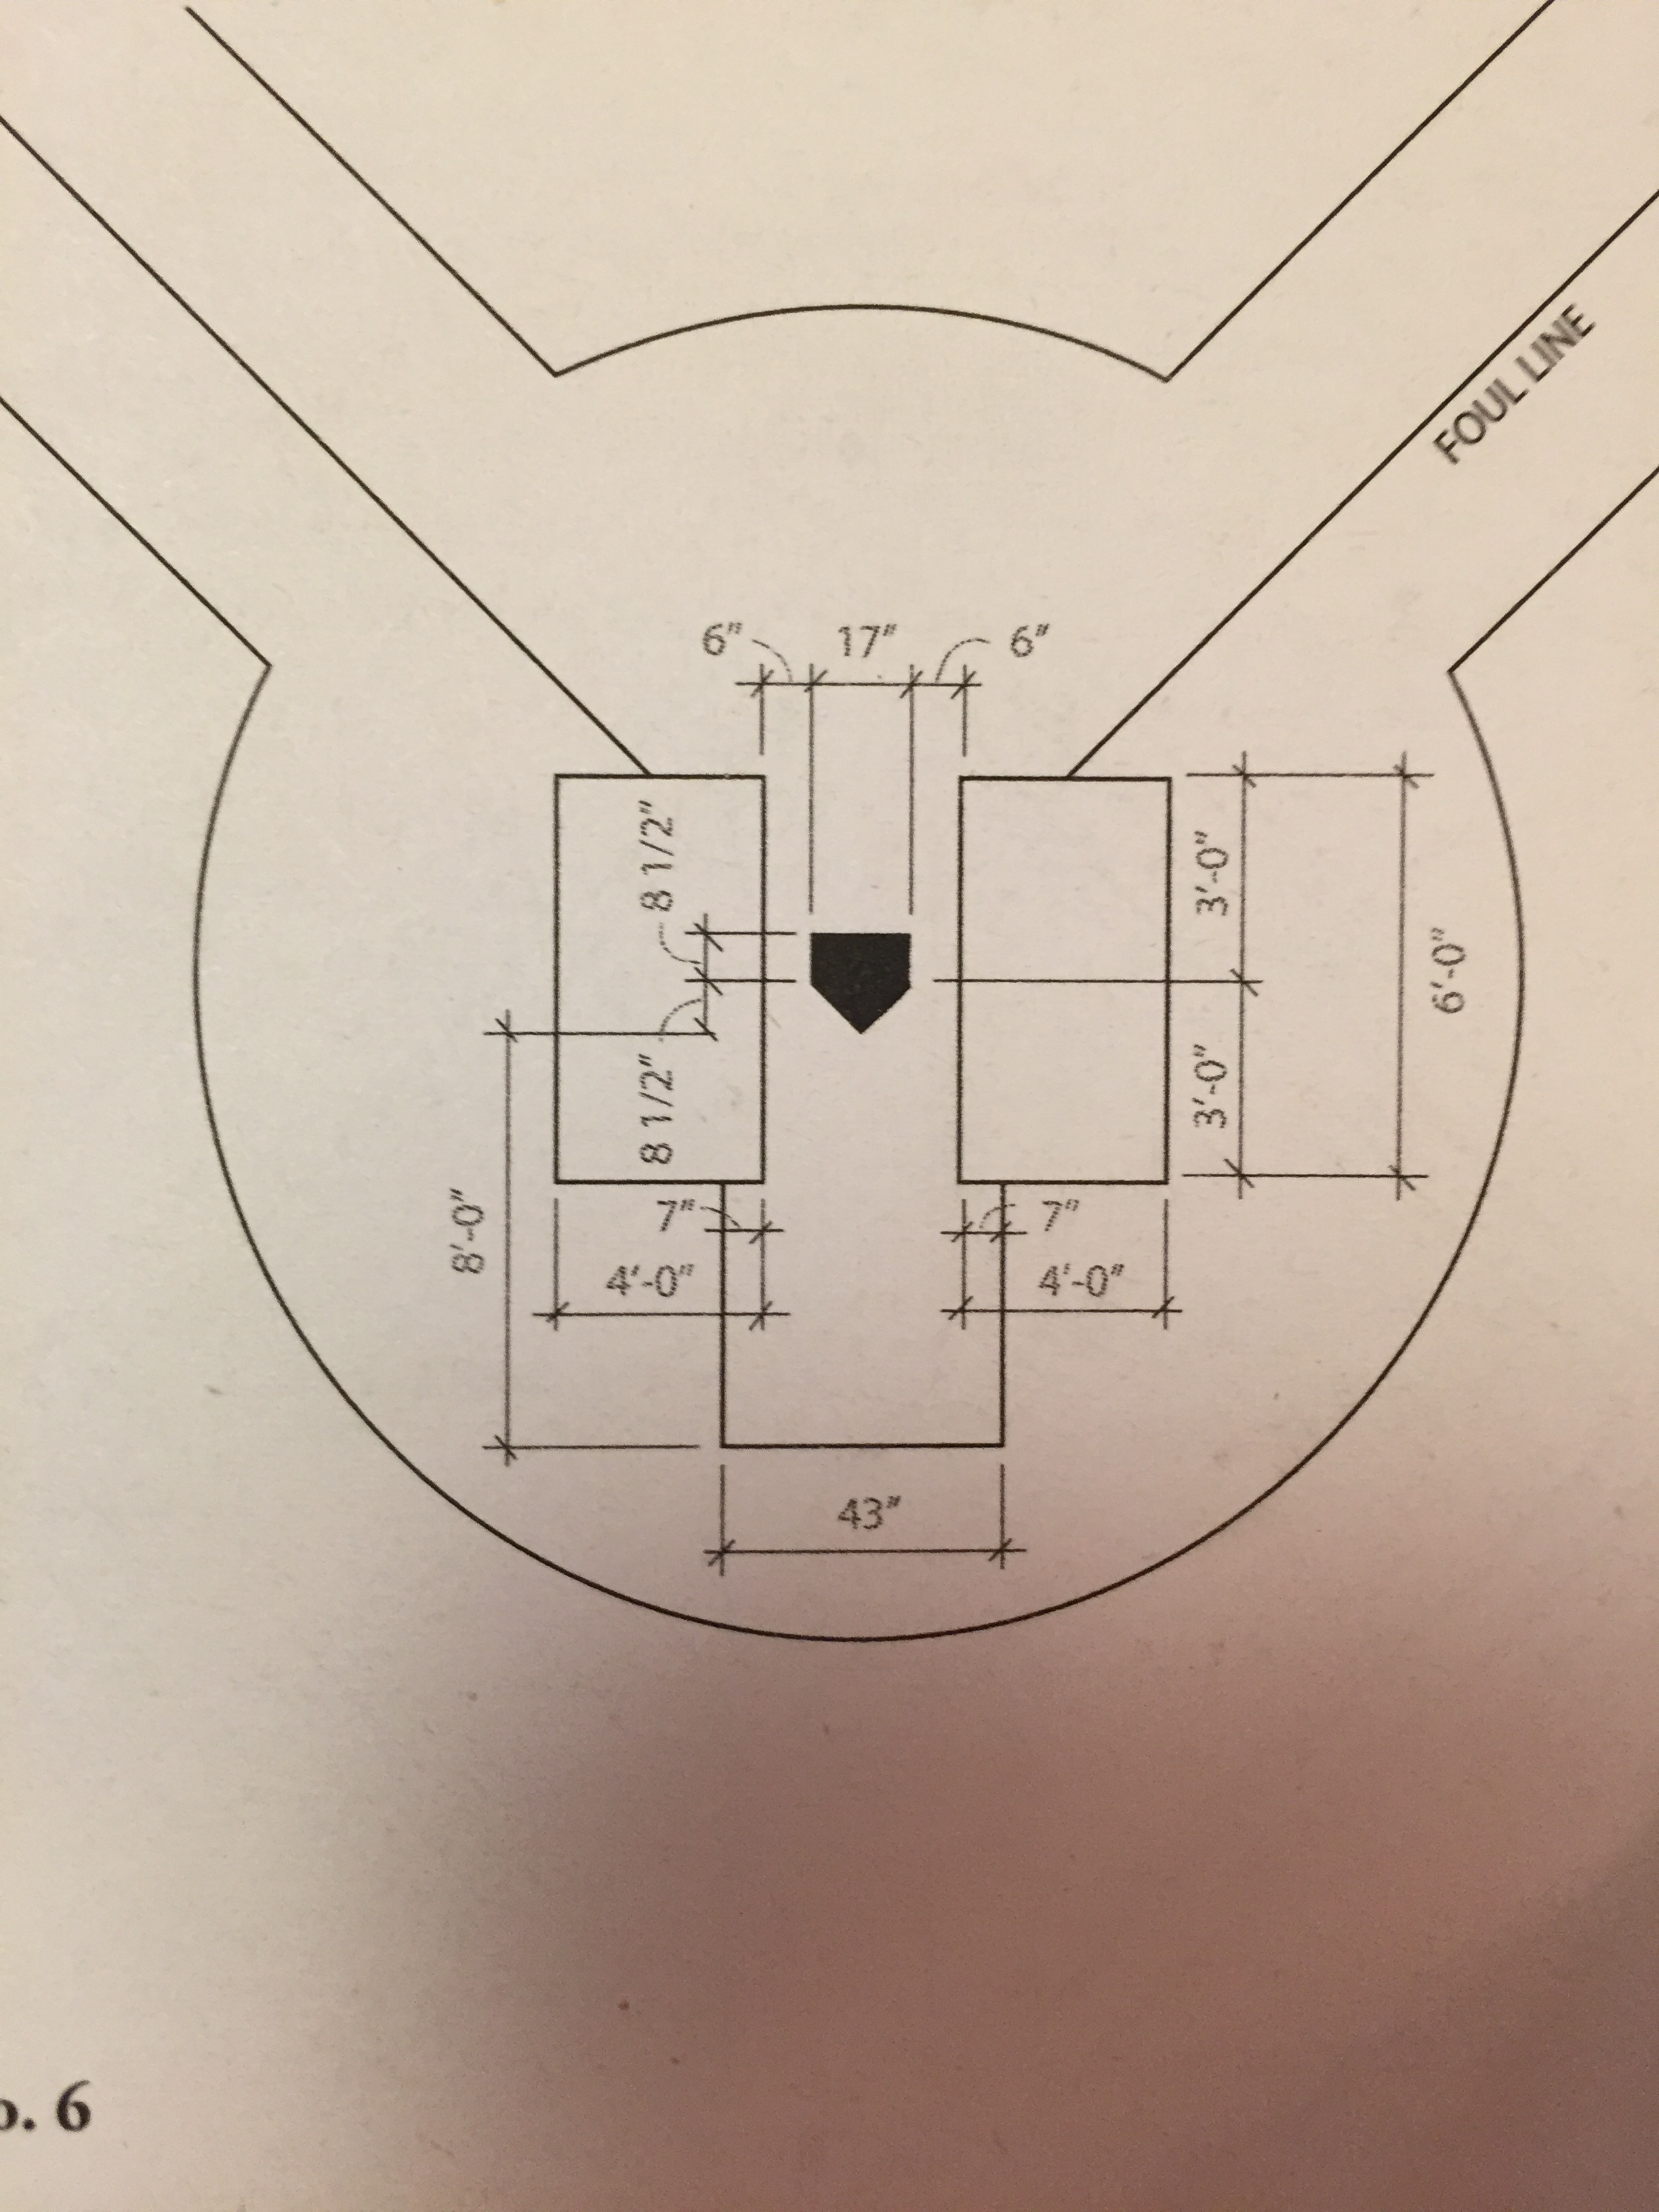
6.03 The Batter’s legal position is with both feet in the box-
The lines are within the
Batter’s Box
Junior/Senior Box 4x6
3’ from midpoint of plate
Inside Line is 6” from Plate

Slide 6
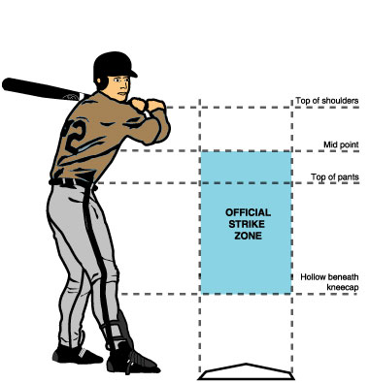
Little League Strike Zone is:
The space over Home Plate which
Is between the Batter’s armpits and
the top of the knees when the Batter
assumes a natural stance
23 inches
24 inches
The plate is 17” wide, the ball is
approximately 2 ¾” in diameter,
giving you 22 ½” zone before you
extend it.
Remember all pitches are “Strikes”
until they become a “Ball”

Slide 7
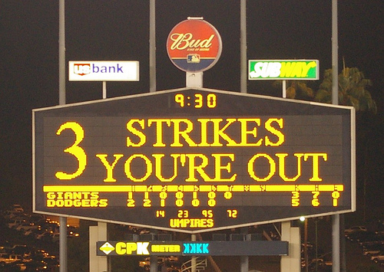
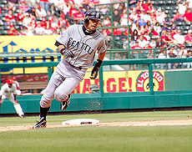
6.04 The Batter has completed his time at bat when he has been
retired or becomes a base runner.

Slide 8
6.05 A Batter is out when:
B: A third strike is not caught, but 1st base is occupied with less than 2 outs.
E: The Batter attempts to hit a third strike and is touched by the ball.
G: After hitting or bunting a fair ball, the bat hits the ball a second time
The Batter drops the bat and the ball rolls against the bat in fair territory----
Umpire’s Judgement- Was it intentional?
J: The Three Foot line, running in and running out
K: An Infielder intentionally drops a fair fly ball or line drive (contact )
M: Runner attempting to steal home, with 2 outs, the pitch is in strike zone and the ball
touches the runner. If less than 2 outs, It’s still strike three, but the ball is dead and
the run counts.

Slide 9
6.06 A Batter is out for illegal action when:
(A) Hitting the ball while out of the Batter’s box
(B) Switching boxes when pitcher is ready to pitch
(C) Interfering with Catcher’s fielding or throwing by:
1- Stepping out of the box
2- Making any intentional movement that
hinders the Catcher’s actions
3- Failing to make a reasonable effort to
vacate a congested area-
All are Judgement Calls
(D) Enters the box with illegal bat or violation
is discovered before next batter enters box

Slide 10
6.06 (D) Notes:
Defensive Mgr. may take result of play- immediate notification to umpire
1st Violation- one adult coach off the bases
2nd Violation- Manager Ejection
Subsequent Violations- Keep tossing Mgr. replacements
Just because the managers sign our voucher does not keep us from enforcing
this rule when we see it.

Slide 11
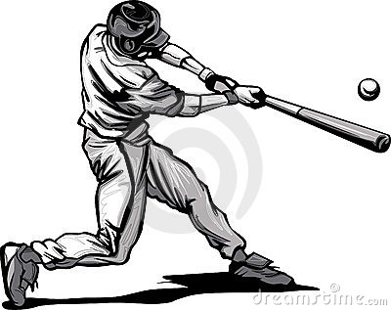
6.07 Batting Out of Turn
If appealed during the at bat, proper batter
assumes the count.
Any runner’s advance during the improper at
bat, besides a hit or sacrifice, are legal.
The appeal must take place before the next pitch
or (attempted) play
Any appeal thereafter is “nothing”- Life goes on-
as if it never happened.
XXX

Slide 12
6.08 The batter becomes a runner without
liability to be put out when:
(A) Four Balls (A2) Majors- Defensive Mgr. may elect
to intentionally walk the batter
1) Must request time/ time must be granted
2) Dead ball, other runners advance if forced
3) 4 pitches added to pitch count
(B) The Batter is hit by pitch-
- Pitch in the strike zone?
- Did the Batter swing?
- Did he attempt to avoid getting hit?

Slide 13
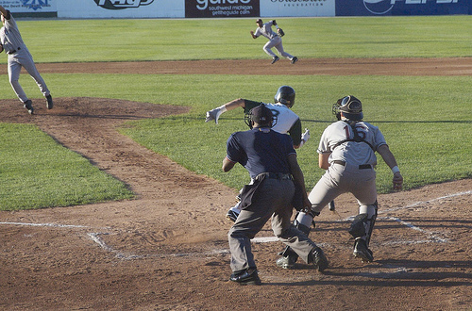
6.08 The batter becomes a runner without
liability to be put out when:
(C) The Catcher or any Fielder interferers with the batter
- If play follows, the Offensive Mgr. may immediately
accept the result of the play. However, if the batter
reaches 1st base all runners advance at least 1 base,
the plays stands without reference to interference.
(D) A fair ball hits an umpire or a runner before touching
a fielder.

Slide 14
6.09 The Batter becomes a Runner when:
Fair Ball is hit
Dropped 3rd Strike- 1st base is unoccupied or 2 outs
Passes a Fielder, other than the Pitcher, or touches any
fielder and then touches an umpire or a runner
Leaves the Playing Field after becoming Fair- Homerun,
under or over a fence, etc,
Any “bounding” Fair ball deflected by a Fielder into Dead
Ball Territory (2 Base Award) except if another Ground
Rule superceeds

Slide 15
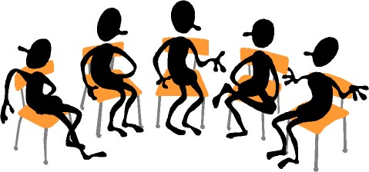
No Meeting Next Week
Next Meeting is February 16

